Slide 1
The Silver Tsunami
A Cross-National Analysis of Fertility Decline, Longevity and Population Ageing, 2000–2040
“‘Silver tsunami’ is a popular metaphor for rapid population ageing; this analysis tests it with data.”
TEAM: DATA ARCHITECTS
Awowole Uthman • Makinde Teslim • Ikeh Emmanuel • Soulaymane Aliyah
uthmanawowole@gmail.com | makindeteslim10@gmail.com | emmanuelikeh2993@gmail.com | aliyahsoulaymane@gmail.com
Notes:
Welcome judges and colleagues. We are Data Architects presenting 'The Silver Tsunami: A Cross-National Analysis of Fertility Decline, Longevity, and Population Ageing from 1950 to 2050'. In this presentation, we test the popular metaphor of an abrupt global demographic shock against rigorous applied statistics across 155 sovereign nations.

Slide 2
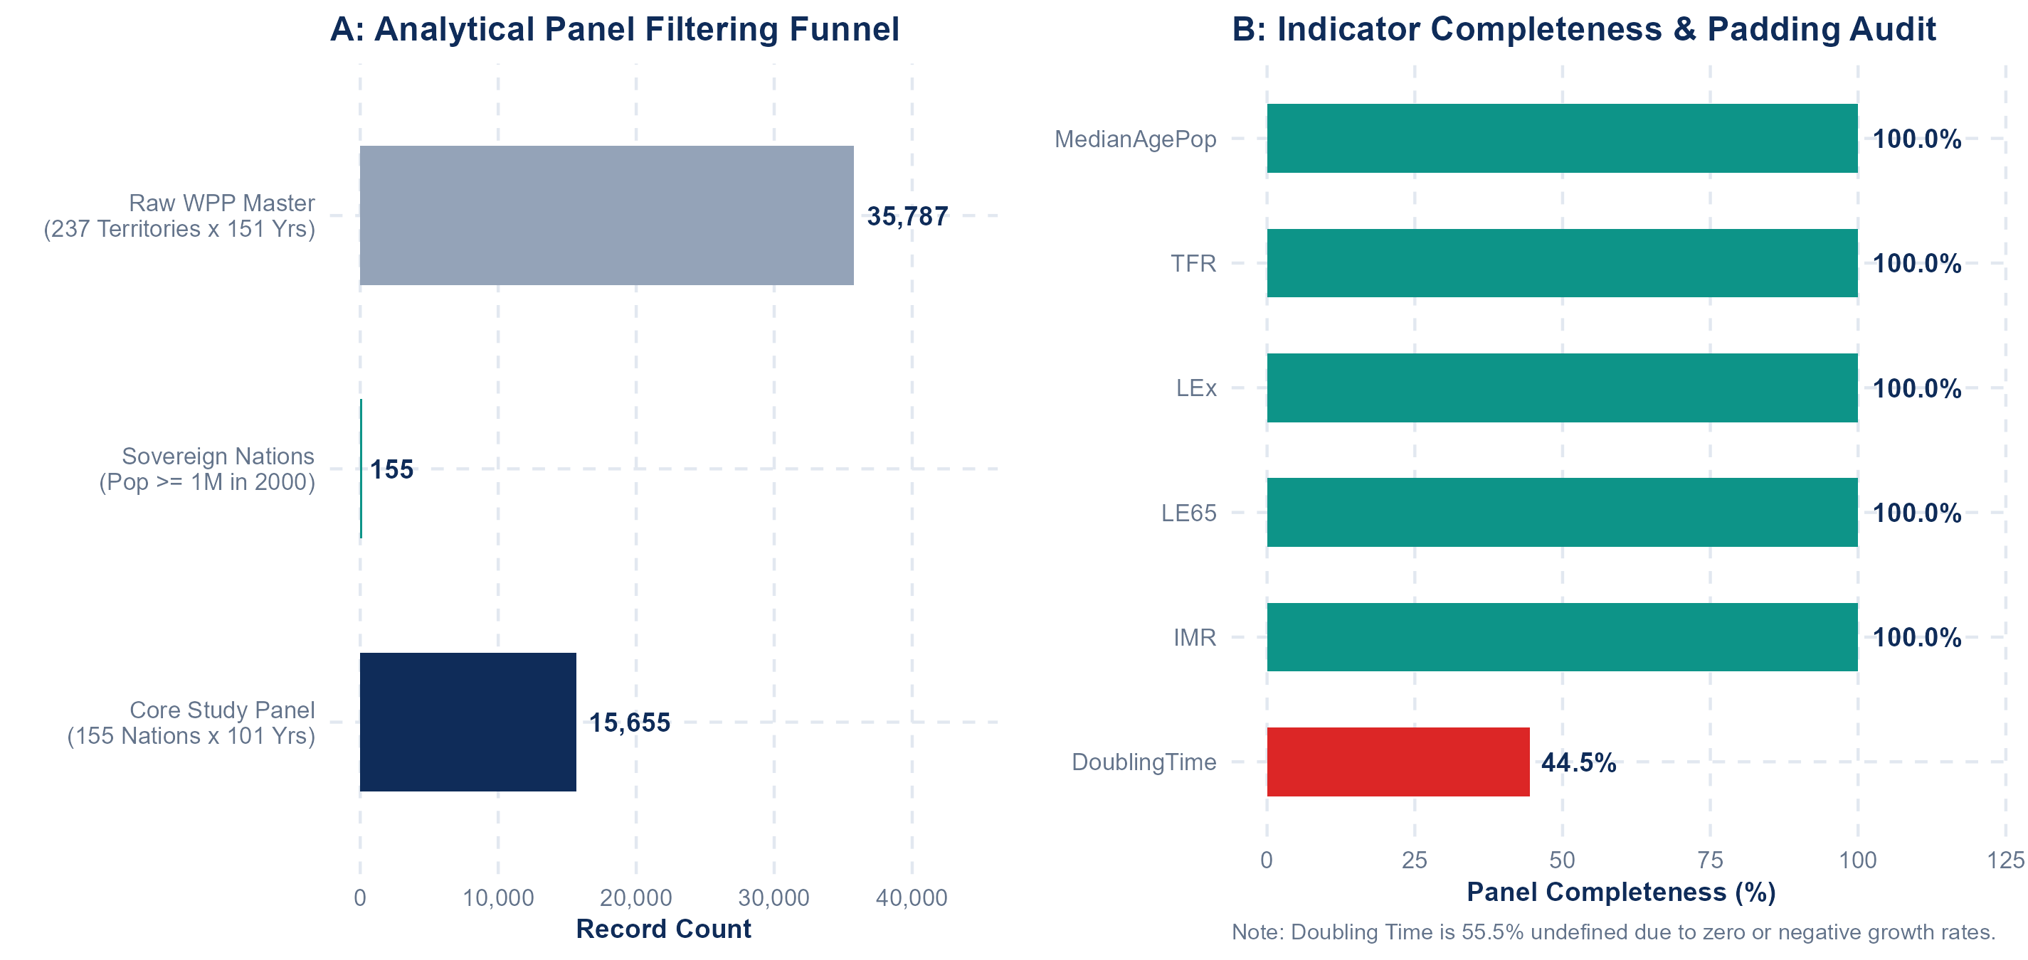
Figure 1: Data Scope & variable selection
On the left, the funnel shows how we narrowed the data. We started with the UN’s raw master file of 237 territories and 35,787 records. We removed 38 regional aggregates and 44 micro territories with fewer than 1 million people in 2000, leaving 155 sovereign nations. Across 101 years, from 1950 to 2050, that gives us a balanced core panel of 15,655 country-years.
On the right, the audit shows our indicators are fully complete: median age, fertility, life expectancy, infant mortality, and more, all at 100 percent. The one exception is doubling time, at 44.5 percent, because it is undefined whenever growth is zero or negative, so we excluded it from the analysis.
Values from 1950 to 2023 are UN estimates, and 2024 to 2050 are UN medium-variant projections. So the analysis rests on a clean, complete, and comparable foundation.
Notes:
Slide 2 outlines our data cleaning funnel and completeness audit. Starting from 237 territories, we filtered out regional aggregates and micro-territories with population under 1 million, yielding 155 sovereign nations and 15,655 balanced country-years. Core variables achieved 100% completeness, while DoublingTime was excluded due to division-by-zero singularities in shrinking populations.

Slide 3
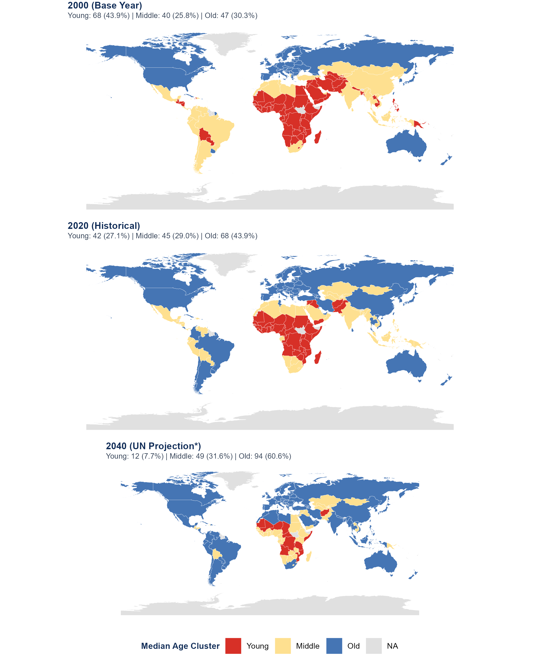
Figure 2: Median Age clustering diagram for (2000, 2020, 2040)
On the left, the maps show how countries cluster by median age in 2000, 2020, and 2040, using the year-2000 baseline: Young below 20.6, Middle up to 29.9, and Old above that.
In 2000, 68 countries were young. By 2020, that fell to 42, while old nations rose to 68. By 2040, the UN projects only 12 young countries, about 8 percent, against 94 old ones, roughly 61 percent.
We believe this is not a passing trend but a lasting shift. Within four decades, older societies will outnumber youthful nations by nearly eight to one, a permanent restructuring of global demographics.
Group | 2000 | 2020 | 2040* | Shift
Young (<20.6y) | 68 (44%) | 42 (27%) | 12 (8%) | -56
Middle (20.6–29.9y) | 40 (26%) | 45 (29%) | 49 (32%) | +9
Old (>29.9y) | 47 (30%) | 68 (44%) | 94 (61%) | +47
Notes:
Figure 2 presents our 3-map grid plot tracking median age migration. In 2000, 68 countries had youthful populations. By 2020, 26 countries moved into older categories as fertility declined and longevity expanded. By 2040, under UN projections, youthful nations drop to just 12 countries, mostly in Africa, while 94 nations (61%) enter the mature group.

Slide 4
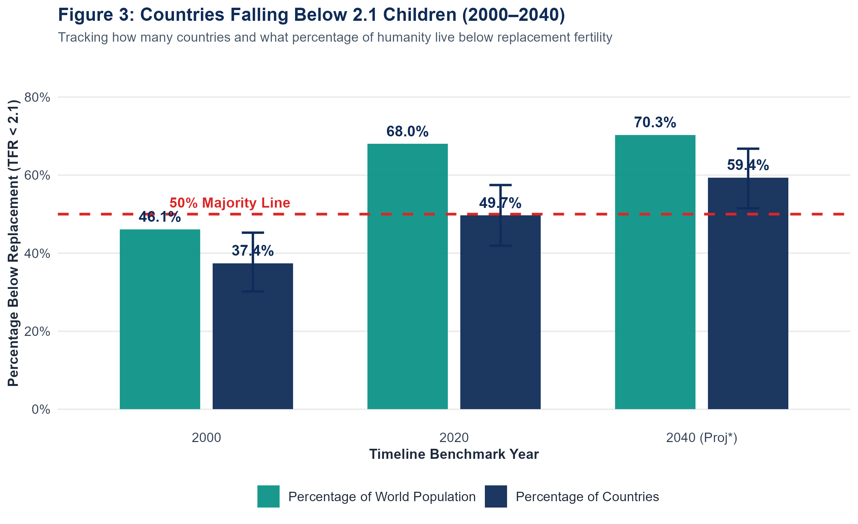
Figure 3: Countries Falling Below 2.1 Children (2000–2040)
On the left, the chart tracks how many countries, and how many people in the world, live below the replacement fertility rate of 2.1 children per woman. This is the level needed to keep a population stable without migration.
In 2000, 58 countries, or 37.4 percent, were below replacement, covering 46.1 percent of the world’s people. By 2020, that rose to 77 countries, just under half, but because populous nations like China and India crossed or neared this level, 68 percent of the world’s population lived in sub-replacement societies. By 2040, the UN projects 92 countries, about 59 percent, and 70.3 percent of the world’s people below replacement.
We believe this decline is largely a one-way transition. Between 2000 and 2023, out of 22 countries that crossed below 2.1, only one rebounded. This thins the inflow of younger cohorts and permanently shapes national age distributions.
Data Architects | ASA DataQuest 2026 • The Silver Tsunami • Slide 4 of 6
Notes:
Figure 3 tracks the percentage of countries and world population below replacement fertility of 2.1 children. In 2000, 37.4% of countries were below replacement. By 2020, this reached 49.7% of countries and 68.0% of the world’s people. Empirically, this is a one-way transition: 21 of 22 nations that crossed below remained below, permanently thinning youth cohorts.

Slide 5
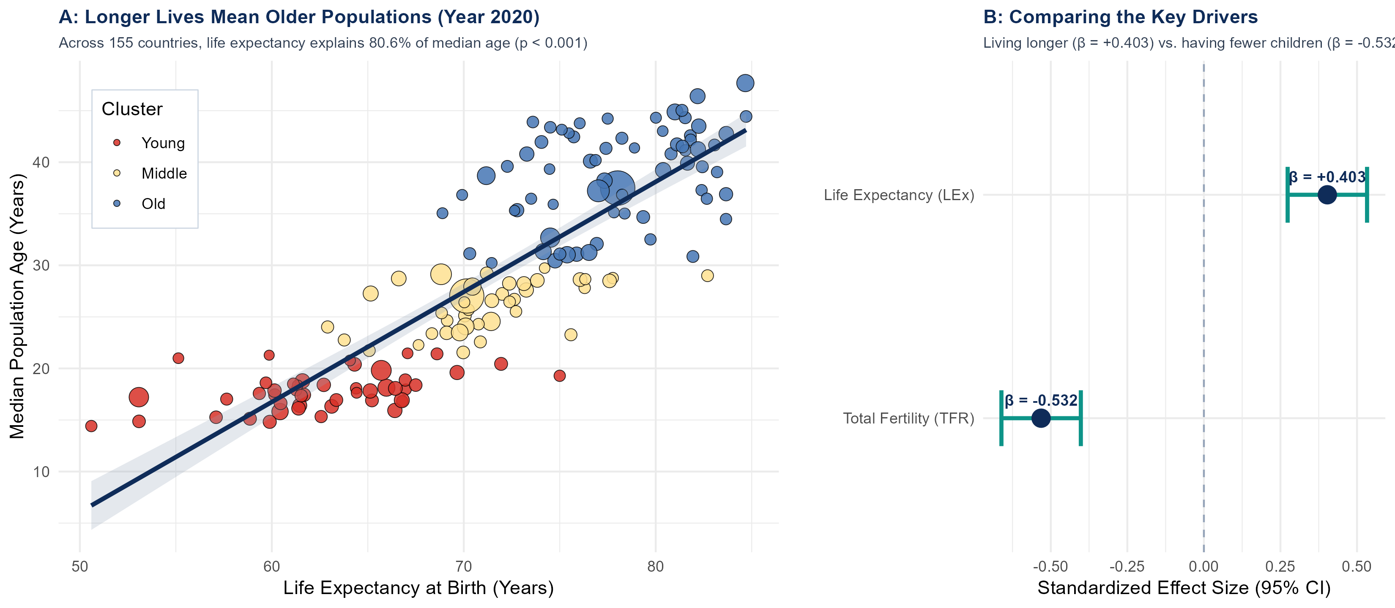
Drivers of median age
On the left, panel A shows that across 155 countries in 2020, the longer people live, the older a country’s median age becomes.
Panel B compares the two main drivers. Life expectancy pushes median age up: every 10 extra years of life adds roughly 5.1 years to a country’s median age. Falling birth rates add to this effect, because fewer children shrink the base of young people. Together, the two factors explain 80.6 percent of the variation in median age.
We also found that in older nations, longer lifespans combined with fewer births caused deaths to overtake births around 2018.
We believe population ageing is not driven by one cause alone. It is mainly the result of people living longer, reinforced by families having fewer children, which slowly turns young, wide-based populations into older, mature ones.
Factor | Effect (β) | t-Stat | p-Value
Life Expectancy | +0.403 | 6.09 | < 0.001
Birth Rate (TFR) | -0.532 | -8.03 | < 0.001
Full Model (R²) | 0.806 | F = 314.9 | < 0.001
Data Architects | ASA DataQuest 2026 • The Silver Tsunami • Slide 5 of 6
Notes:
Figure 4 isolates the statistical drivers of national median age. Life expectancy serves as the primary positive anchor, accounting for over 80% of cross-national variance, with each decade of longevity adding 5.1 years to median age. Combined with fewer births, this results in natural decrease where deaths outnumber births.

Slide 6
CONCLUSION
REFERENCE
The world is ageing steadily: youthful nations fall from 68 in 2000 to a projected 12 by 2040.
By 2020, about 68% of the world’s people lived in countries below replacement fertility (2.1 children per woman).
Longer life expectancy is the main driver of rising median age, reinforced by falling birth rates.
These results show associations, not proven causation.
Due to the ASA DataQuest 6-slide limit, we could not include our statistical diagnostic test results. The full code and details will be available on GitHub: https://github.com/emmanuelikeh2993/asa-dataquest-2026
United Nations, World Population Prospects 2024 (UN WPP 2024)
Google (background research)
Data Architects | ASA DataQuest 2026 • The Silver Tsunami • Slide 6 of 6
Notes:
To conclude, the world is ageing steadily. Youthful nations shrink from 68 to 12 by 2040, and by 2020 about 68% of the world’s people already lived below replacement fertility. Longer lives are the main driver of rising median age, reinforced by falling birth rates. To be honest, these results show associations, not proven causes. Because of the ASA DataQuest six-slide limit, we could not include our statistical diagnostic test results, but our full code and details will be available on GitHub. Our data comes from the UN World Population Prospects 2024, with Google used for background research. Thank you, and we welcome your questions.

